Slide 1
Zero Conditional (0)
If you spend £50 at that supermarket, you get a five percent discount.
If you cross the international dateline, the time changes.
Water boils if you heat it to 100 degrees.
Rule: Zero conditionals express a situation that is always true. If means when or whenever.

Slide 2
First Conditionals (I)
Which sentence expresses a future certainty, and which a future possibility?
    ‚If I see Anna, I‘ll tell her.‘
    ‚When I see Anna, I‘ll tell her.‘
Which are the time expressions? Which tenses are used in the time clauses?
  ‚When we get there, we‘ll give you a call.‘
  ‚As soon as we find a place to live, we‘ll send you our address.‘
  ‚You‘ll have to wait until we‘ve set up our computer.‘
Which tenses are used in the time clause?

Slide 3
Second Conditionals (II)
‚If I have the time, I‘ll post the letter.‘
‚If I had £5 million, I would buy an island.‘
Which sentence expresses a possible situation?
Which sentence expresses an unlikely or unreal situation?
Complete each of these sentences to show the real situation.
‚If I had a lot of money, I‘d travel around the world.‘
(But unfortunately, I ...‘)
‚If I had a car, I‘d never catch a bus again.‘
(But unfortunately, I ...‘)
‚If I didn‘t have to work today, I would be at home.
(But unfortunately, I ...‘)

Slide 4
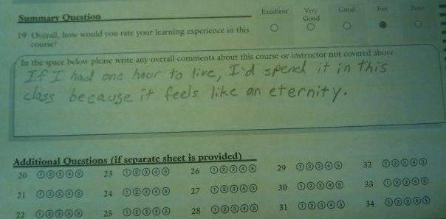
Second Conditionals (II)

Slide 5
What do you think?
Imagine that you have £105,000 that you want to give to charity. Who would you give the money to? How would you divide it?
Think about what you would do, and then discuss your ideas with a partner.
Charity for elderly people
Hospice for people who are dying of incurable disease
Organization providing emergency supplies for disaster victims
Charity helping homeless people
Cancer research
Charity helping people with AIDS
Animal rescue shelter

